Slide 1
Stock Exchange Database
CSE 111 – Database System
Project Checkpoint 1
Ajay Grewal
Rohit Kumar
Arshdeep Dhaliwal

Slide 2



The Team
Ajay Grewal Contact: agrewal20@ucmerced.edu
Rohit Kumar
Contact:
rkumar43@ucmerced.edu
Arshdeep Dhaliwal
Contact:
adhaliwal25@ucmerced.edu​

Slide 3
Project Background
Purpose:
To Design a database system that simulates how a trading platform like Rohin hood manages user, stocks, and transactions.
Problem:
Many students and beginner investors want to practice stock trading, but real trading apps require money and carry risk.
Solution:
Create a mock stock exchange database where users can register, view stock information, manage a virtual portfolio, and make simulated buy/sell transactions.

Slide 4
Project Requirements/ Objectives
• Allow users to register new accounts and log in securely.
• Store user information and virtual account balance.
• Display available stocks with their name, symbol, and price.
• Enable users to add or remove stocks from their watchlist.
• Let users buy and sell stocks using virtual currency.
• Record every transaction in the database.
• Show each user’s portfolio and its current value.
• Maintain company and market information for each stock.
-Goal: Design a normalized, query-efficient database to support all user interactions.

Slide 5
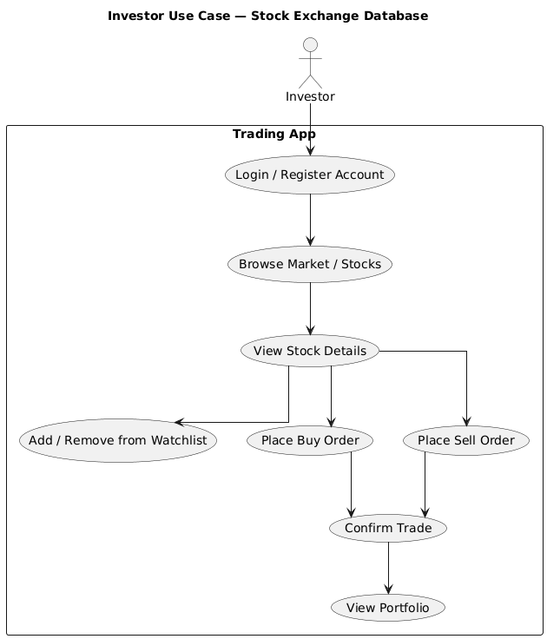
Use Case Diagram- User (Investor)

Slide 6
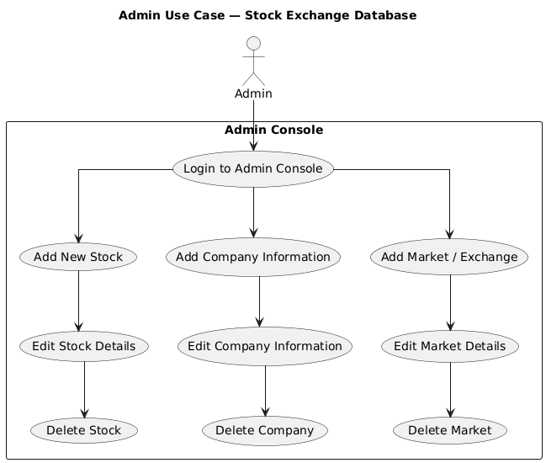
Use Case Diagram - Admin

Slide 7
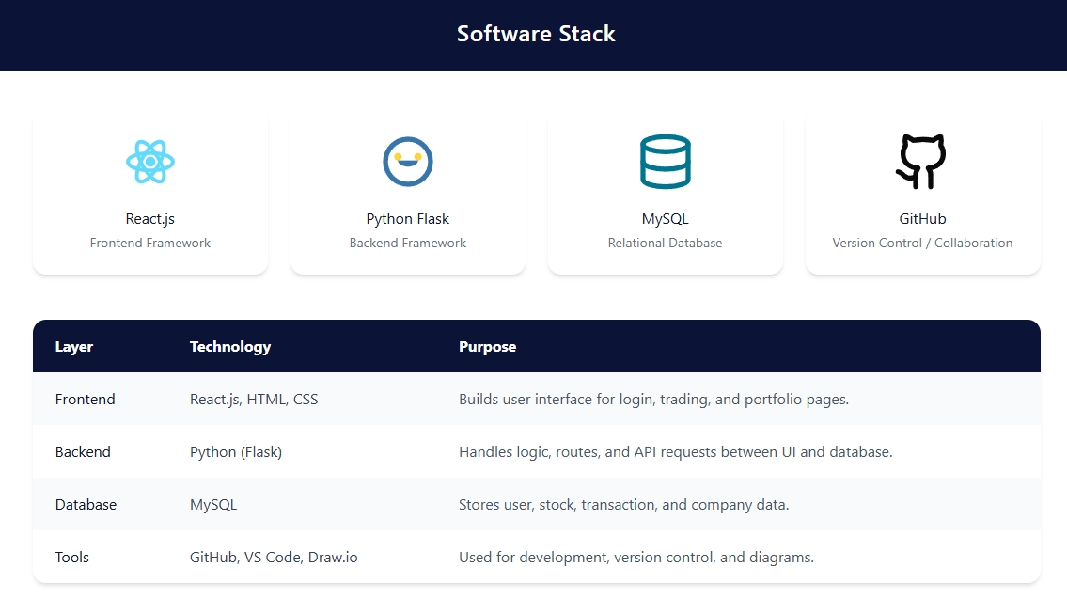
Software Stack

Slide 8
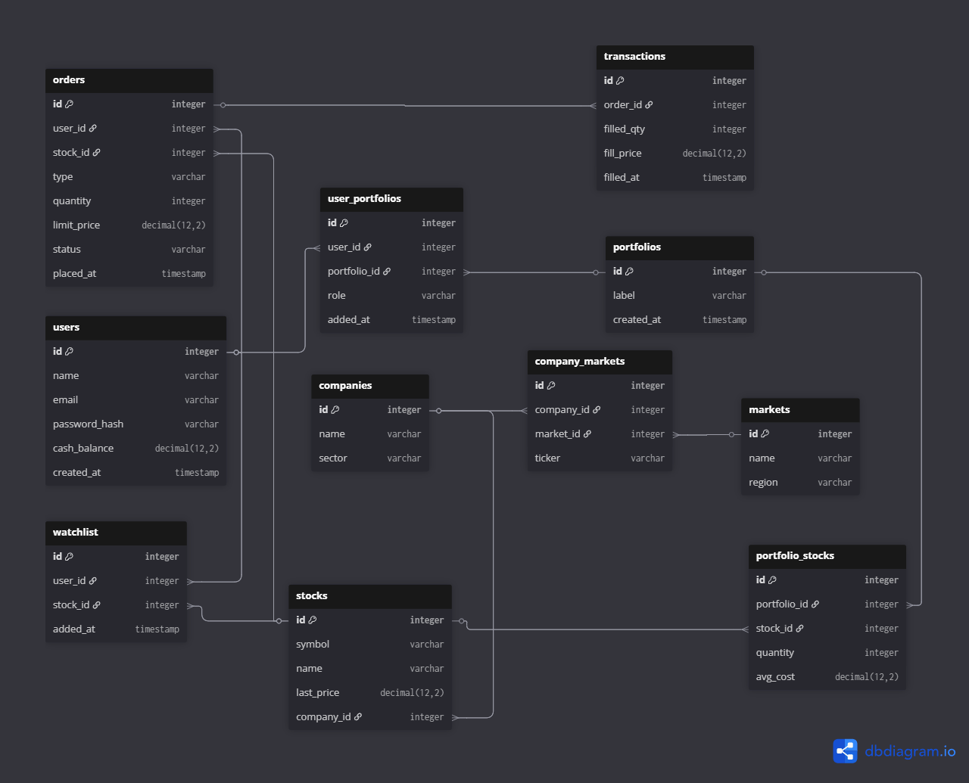
E/R Diagram

Slide 9
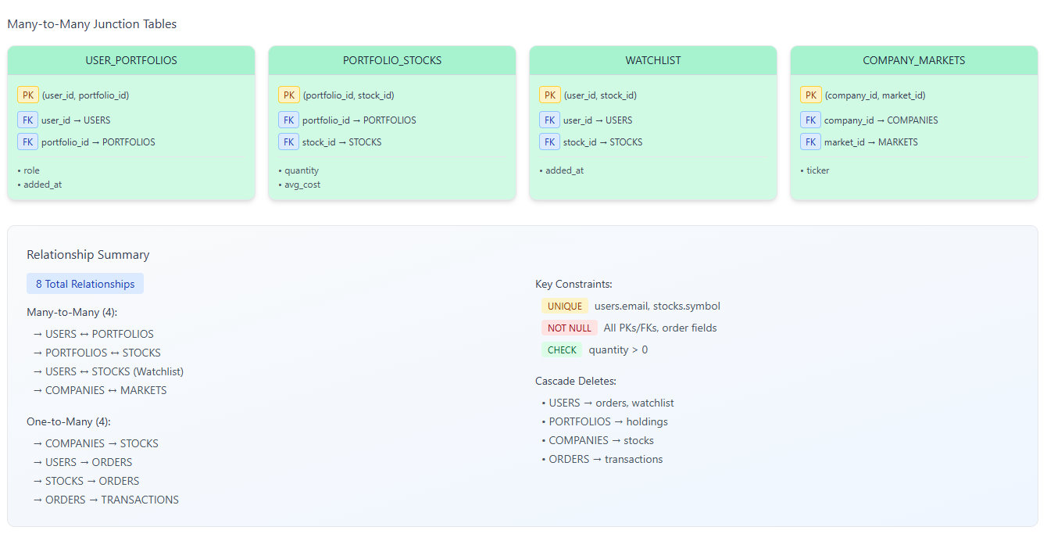
Relation Specifications

Slide 10
The Team
Ajay Grewal Contact: agrewal20@ucmerced.edu
Rohit Kumar
Contact:
rkumar43@ucmerced.edu
Arshdeep Dhaliwal
Contact:
adhaliwal25@ucmerced.edu​

Slide 11

Thank you!!!

